Slide 1
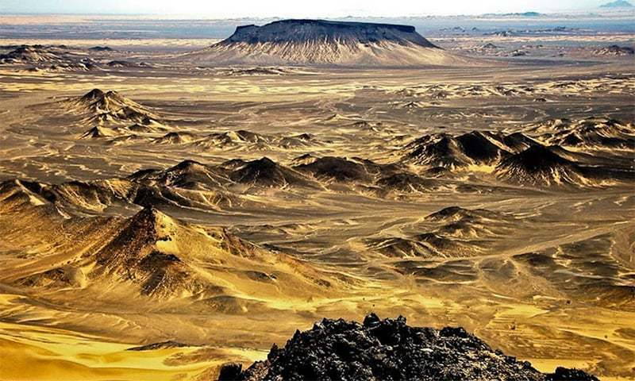
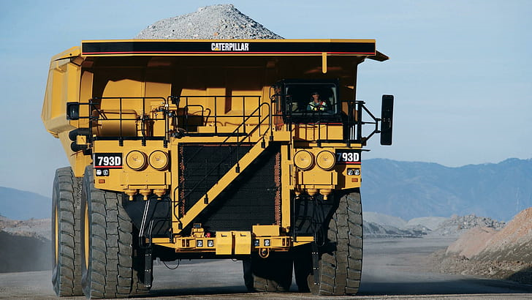
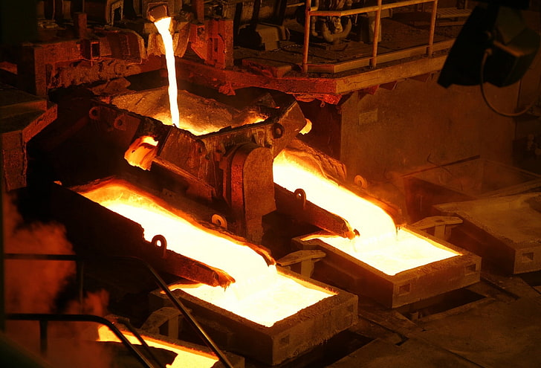

BALOCHISTAN MINERAL RESOURCES LIMITED
(BMRL)

Slide 2

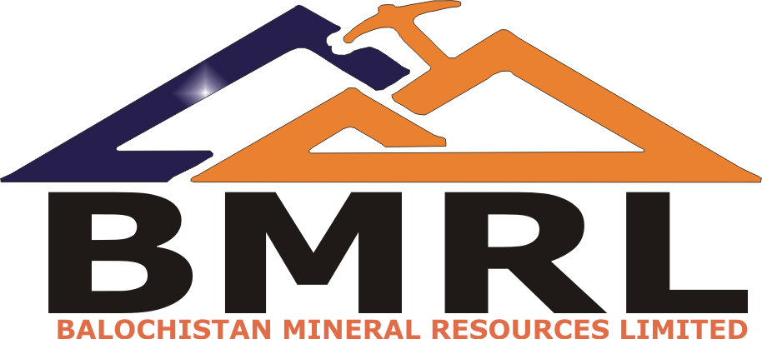
BMRL
Government of Balochistan (GoB) has incorporated Balochistan Mineral Resources Limited (BMRL) as its 100% owned commercial mineral arm.
BMRL is responsible for undertaking all strategic decisions pertaining to attract foreign & local investment in the mineral resource sector.
GoB seeks to develop its mineral resources in a strategic, transparent and systematic manner that will ensure provincial prosperity and long-term use of indigenous resources & workforce capacity building.
BMRL facilitates and coordinates all the investors in seeking licenses, permits along with technical & commercial assistance within the mineral resource sector.

Slide 3
Objectives
Create necessary enablers/environments for mineral development.
Attract foreign and local investors by creating commercially attractive mineral projects.
Focus on value addition through mineral processing and industrial zones.
Engage local communities to create trust between investors and communities.
Represent GOB in large/SME scale mineral projects.
Protect strategic interest while dealing with large-scale mining players in the province.
Ensure sustainable development encompassing a broad-based stakeholder approach through engaging the community and protecting the environment.

Slide 4
Balochistan: Unveiling a Wealth of Minerals and Vast Terrains
Balochistan, the largest province of Pakistan
sprawls across approximately 347,190 square kilometers of diverse landscapes, encompassing deserts, mountains, and a breathtaking 800 kilometers coastal belt along the Arabian Sea.
Balochistan province hosts a treasure trove of valuable resources, including copper, gold, coal, chromite, lead-zinc, onyx, marble, manganese, iron ore, antimony, and more
Its strategic location, coupled with a wealth of minerals, positions Balochistan as a focal point for investment, exploration, and development within Pakistan's mining sector.

Slide 5
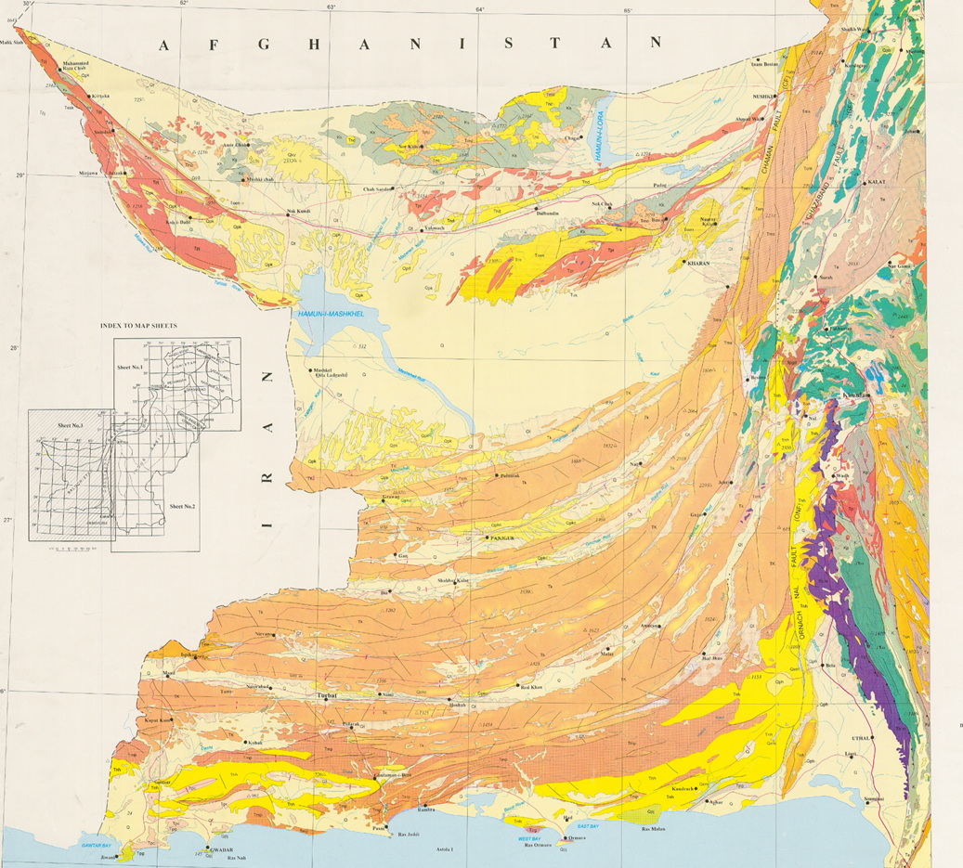
Balochistan Mineral Wealth
Chagai Hills
Ras Koh Arc
Ophiolitic Belt

Slide 6
Facilitating Joint Ventures for Prosperous Endeavors
Balochistan Mineral Resources Limited (BMRL) and Balochistan Mineral Exploration Company (BMEC), th e two Provincial Government owned companies
Act as facilitators, providing comprehensive assistance to joint venture partners seeking to navigate the complexities of exploration and mining operations within Balochistan.
BMRL has acquired significant important exploration licenses, including EL-301, EL-302, EL-303, and EL-304 in the North-East Chagai region for Copper-Gold and associated minerals in addition to EL-200 for Lead-Zinc exploration in District Khuzdar.
BMEC, on the other hand, has obtained four new Exploration Licenses—EL-255, EL-256, EL-310, EL-311—in central and western Chagai, strategically positioned near Reko-Diq, known for Copper-Gold and associated minerals.

Slide 7
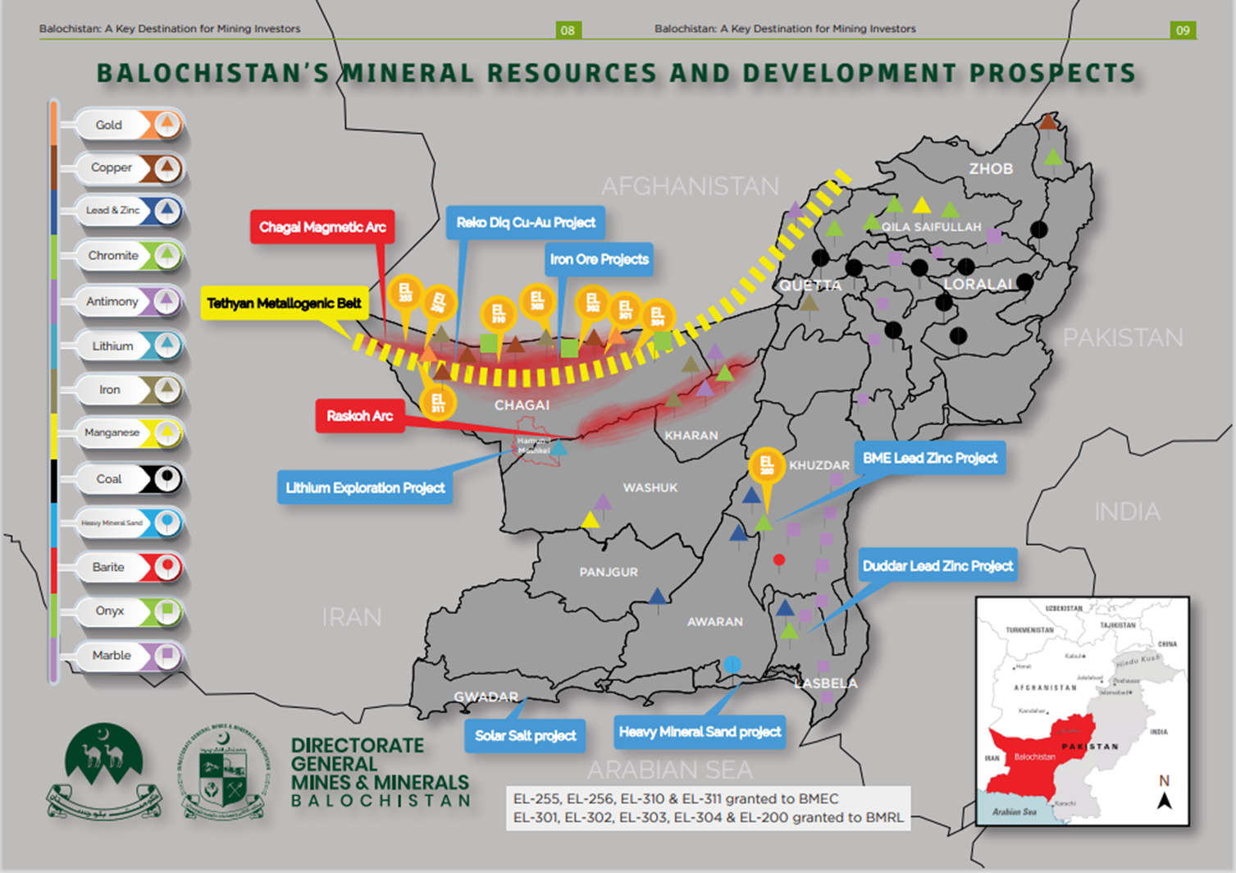
Map Showing BMRL,BMEC & other GOB projects, Balochistan

Slide 8
BMRL Projects
BMRL manages an extensive portfolio of approximately 30 project including Reconnaissance Licenses (RL), Exploration Licenses (EL), and Mining Licenses (ML) and is actively working to increase this number.
With the successful operation of one of the world’s largest undeveloped Reko Diq project under its belt.
BMRL is expanding its reach to establish one of the largest solar salt projects in the region.
The company's ambitious exploration agenda includes a diverse array of commodities such as copper, gold, lithium, lead, zinc, iron, fluorite, antimony, and various salts, positioning it as a multi-commodity prospecting entity with vast opportunities for investment and collaboration.

Slide 9
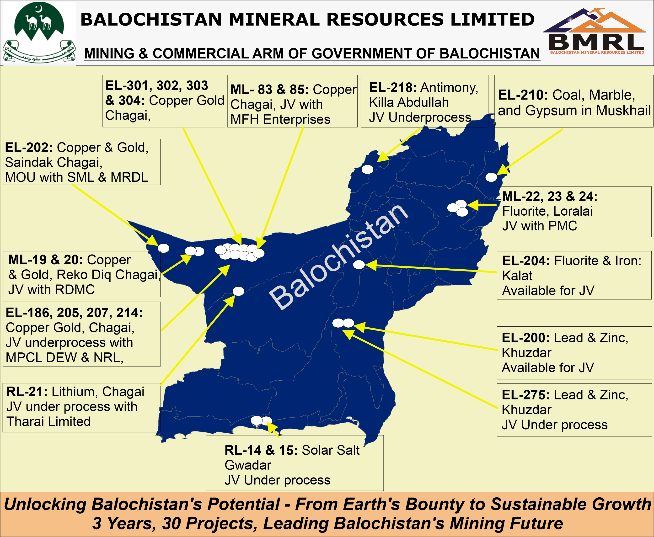
BMRL Project Location
Map

Slide 10
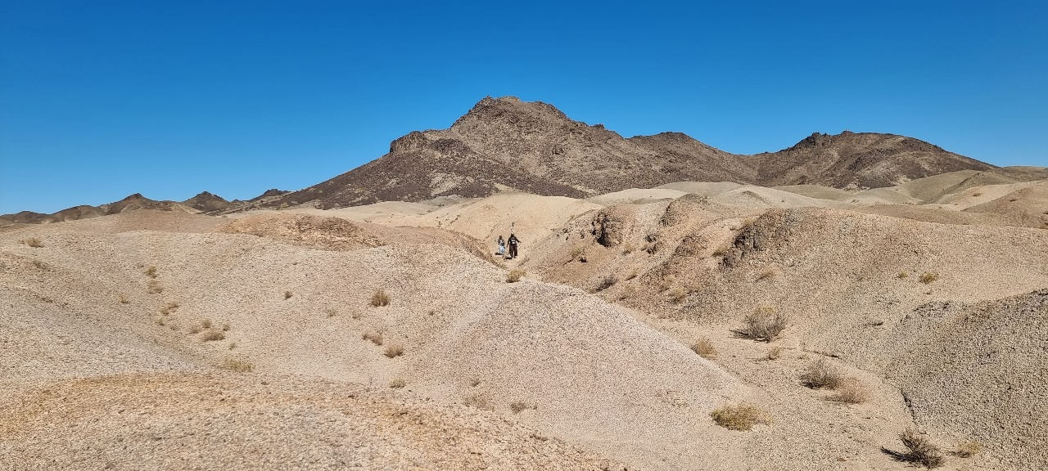
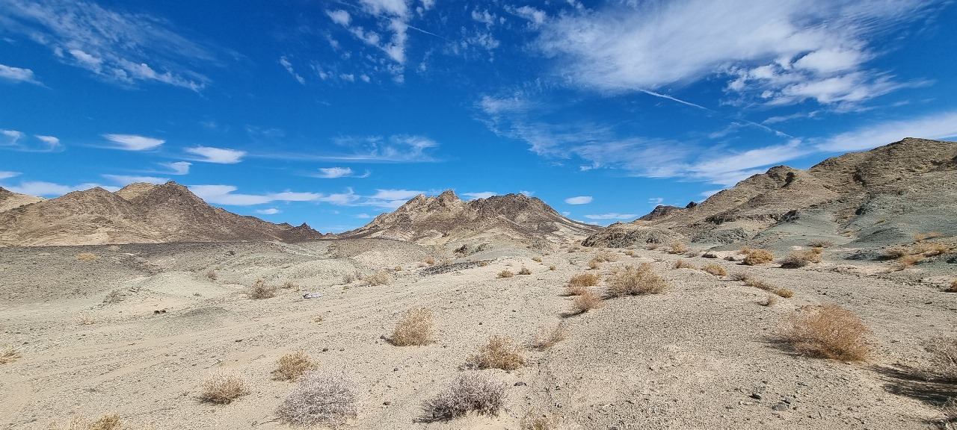
BMRL’s Exploration Lease (Copper & Gold) Photographs, Chagai District, Balochistan

Slide 11
THANK YOU

